Slide 1





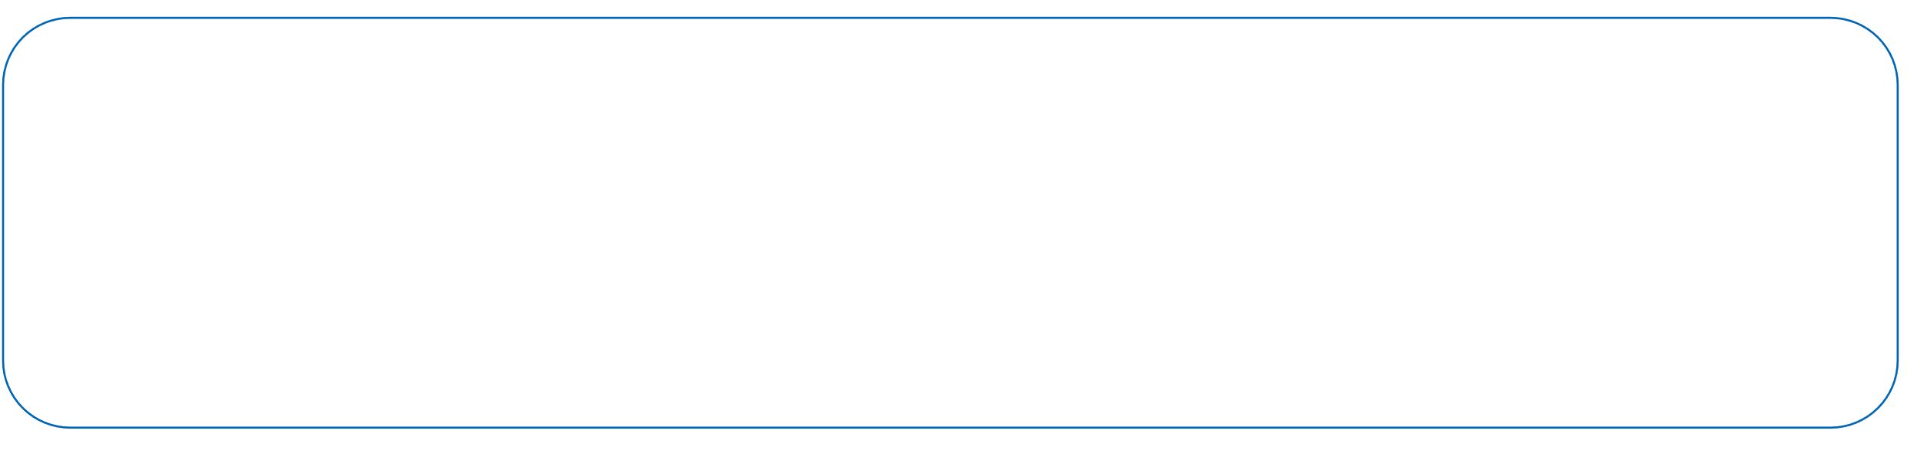
S25' Training Sessions
MOBILE DEVELOPMENT
SESSION 8
#create_share_innovate

Slide 2


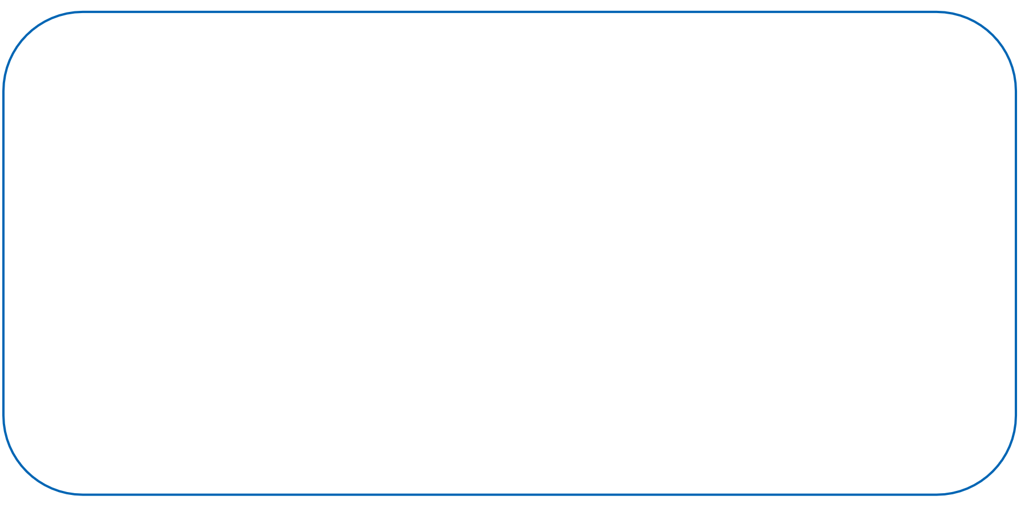
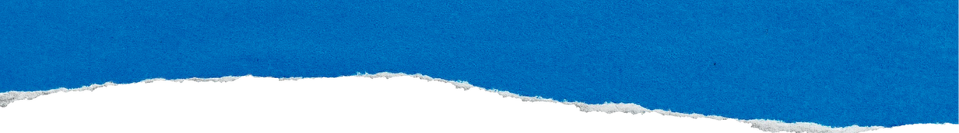


Table of contenet
Navigation and Routing
Recap
Scrolling Widgets
S25' Training Sessions
Responsive Widgets

Slide 3


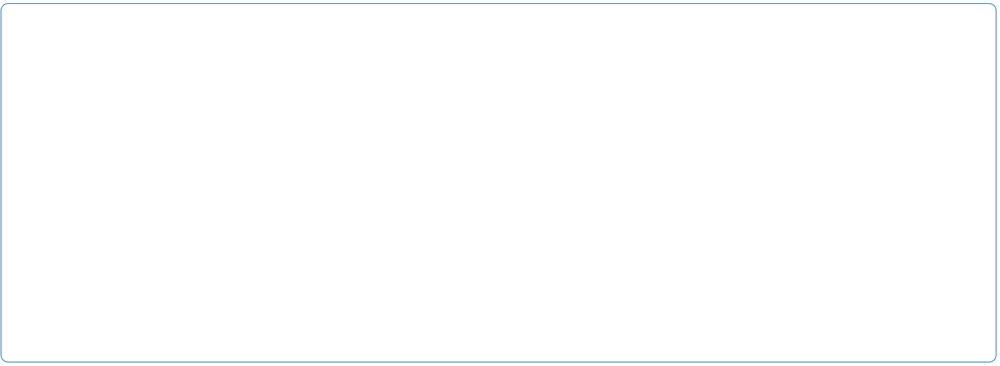
Recap
1.Basic Widgets
Scaffold, AppBar, Text , Buttons , Icons, TextField
2.Layout Widgets
Column, Row, Container, SizedBox, Center
3.Assets
Images, Fonts, Video, Audio
S25' Training Sessions

Slide 4
Scrolling Widgets
What is Scrolling?
Scrolling allows users to navigate through content that doesn’t fit on the screen.
S25' Training Sessions
Why is it important?
Enhances user experience
Essential for lists, feeds, forms, and more

Slide 5
Scrolling Widgets
Flutter provides built-in scrollable widgets:
SingleChildScrollView
ListView
GridView
S25' Training Sessions

Slide 6
Scrolling Widgets
1- SingleChildScrollView
Use When:
You have a small number of widgets
You want vertical or horizontal scrolling
S25' Training Sessions

Slide 7
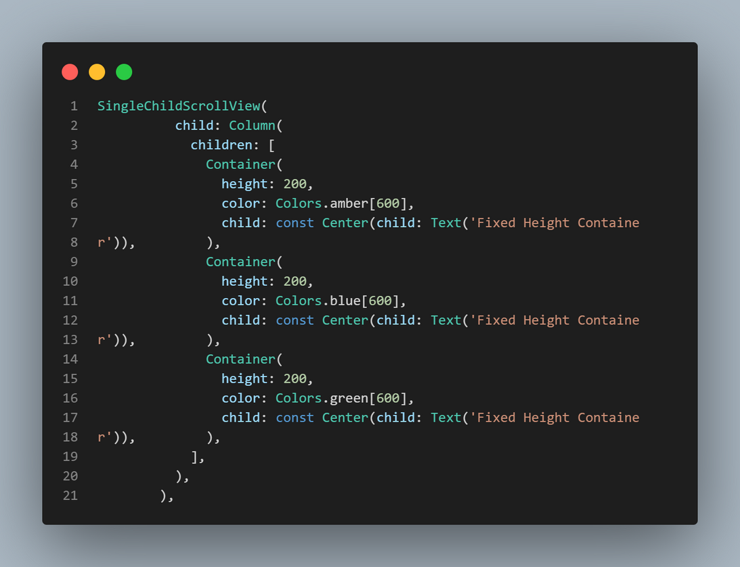
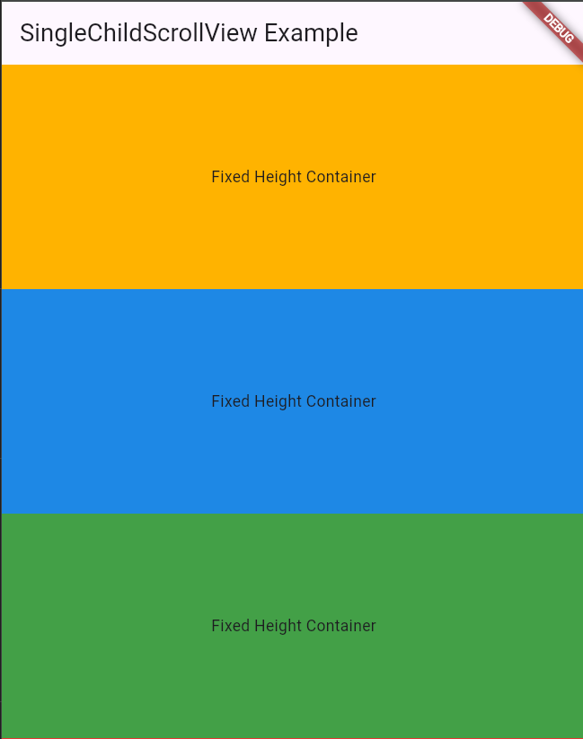
Scrolling Widgets
S25' Training Sessions

Slide 8
Scrolling Widgets
2- ListView
Use When:
You want to display a large or infinite number of items
It handles scrolling efficiently
S25' Training Sessions
Types:
ListView()
ListView.builder()
ListView.separated()

Slide 9
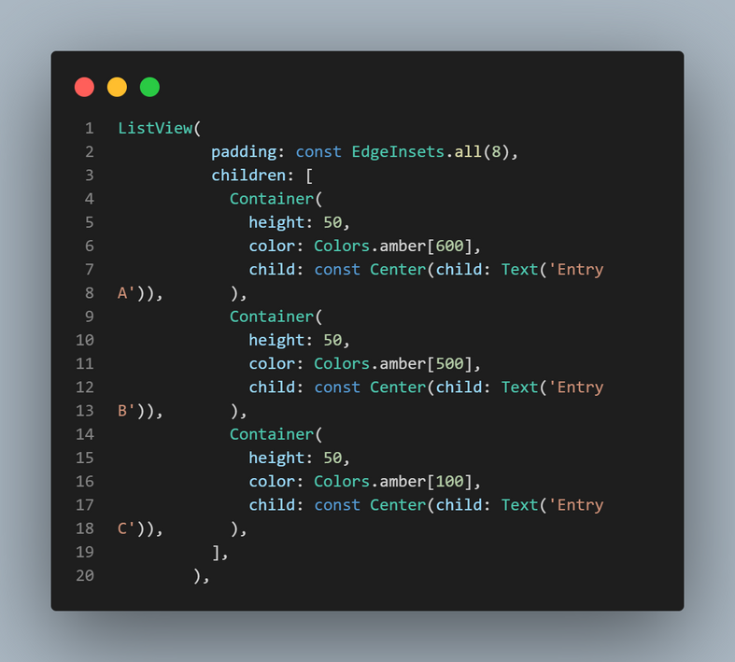
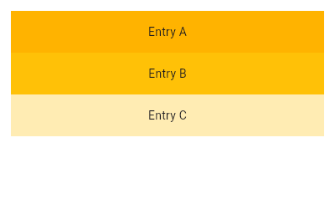
Scrolling Widgets
1-ListView()
S25' Training Sessions

Slide 10
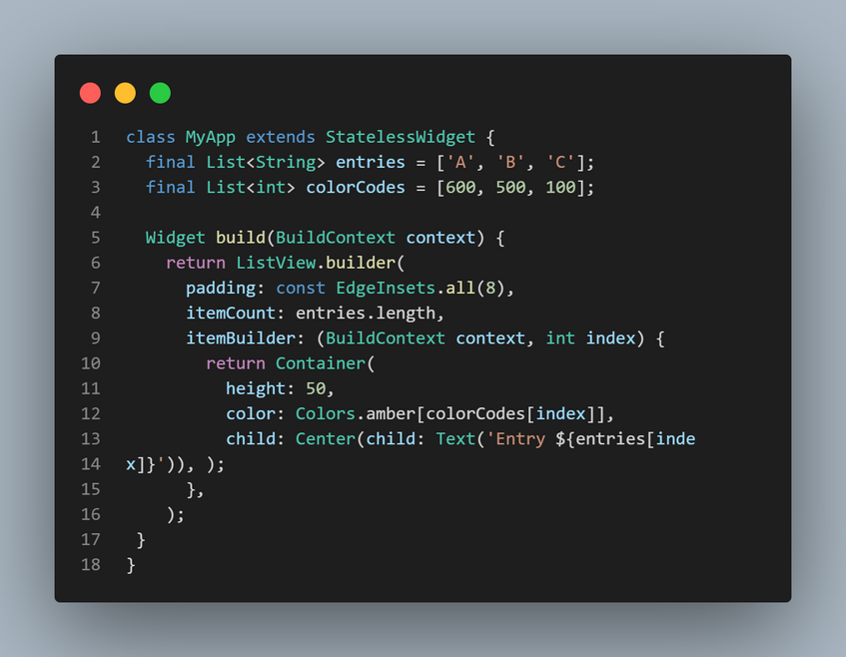
Scrolling Widgets
2- ListView.builder()
S25' Training Sessions

Slide 11
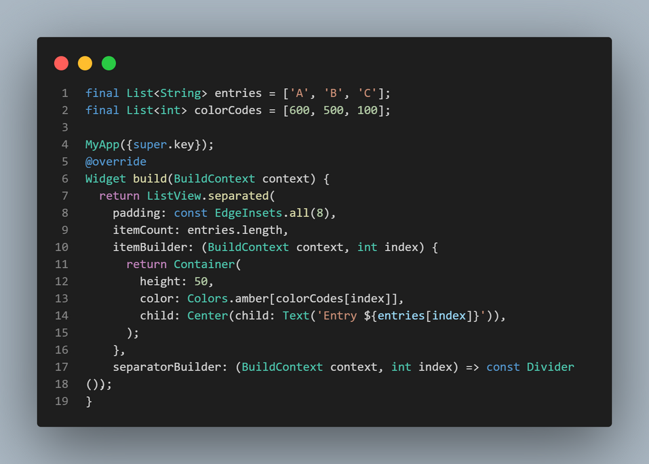
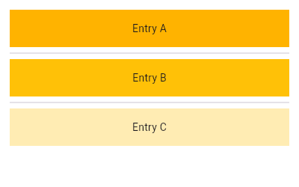
Scrolling Widgets
3- ListView.separated()
S25' Training Sessions

Slide 12
Scrolling Widgets
3-GridView
Use When:
You want to display items in a grid format
S25' Training Sessions
Types:
GridView.count()
GridView.builder()

Slide 13
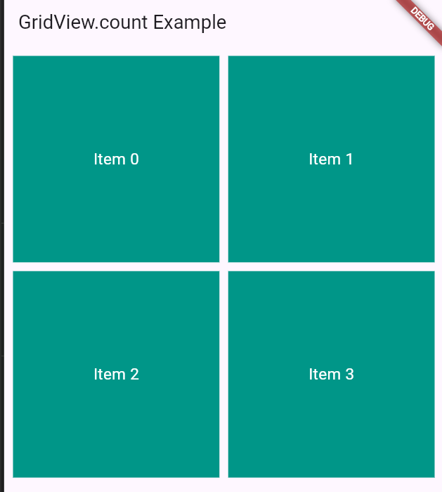
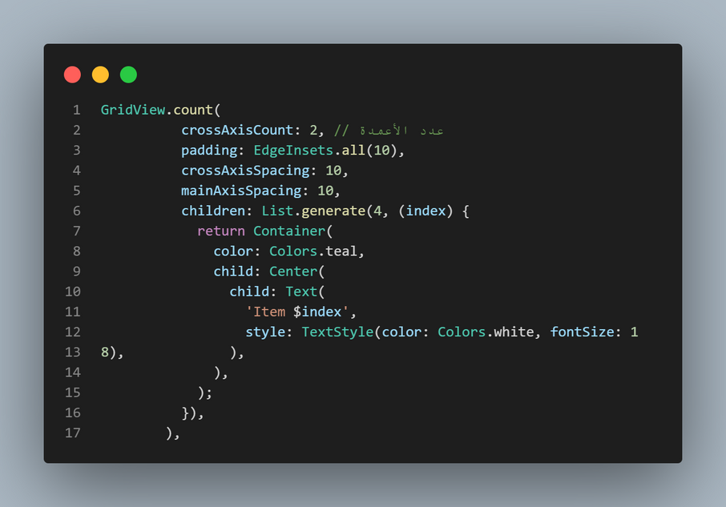
Scrolling Widgets
1- GridView.count()
S25' Training Sessions

Slide 14
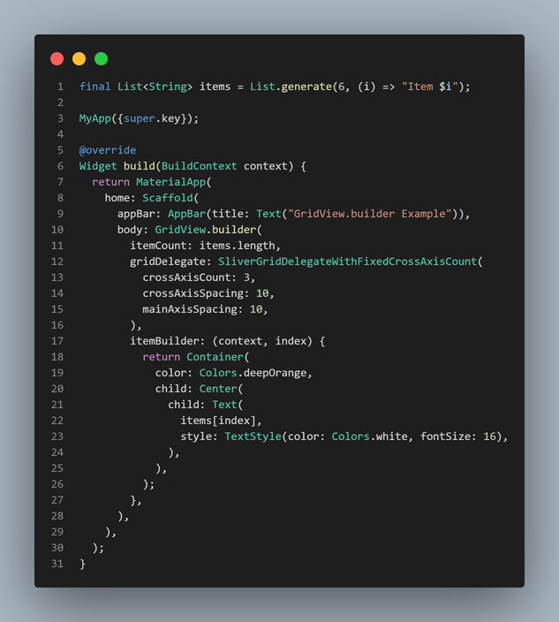
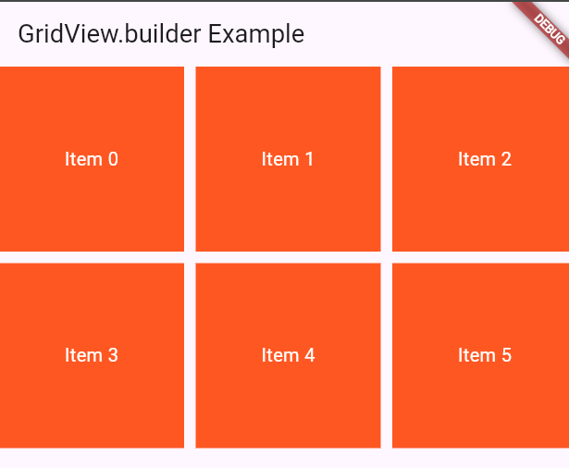
Scrolling Widgets
2- GridView.builder()
S25' Training Sessions

Slide 15
Navigation & Routing
What is Navigation & Routing?
Navigation: Moving between different screens (pages).
Routing: Managing the route (path) to each screen.
S25' Training Sessions
⚠️In Flutter, screens are called Widgets, usually built as StatelessWidget or StatefulWidget.⚠️

Slide 16
Navigation & Routing
Why Use Navigation?
Apps need multiple pages (Home, Settings, Profile).
Enables a smooth user experience.
Makes the app organized and modular.
S25' Training Sessions

Slide 17
Navigation & Routing
Basic Navigation:
S25' Training Sessions
1- Navigator.push(): Navigating to a new screen
2- Navigator.pop(): Going back to the previous screen

Slide 18
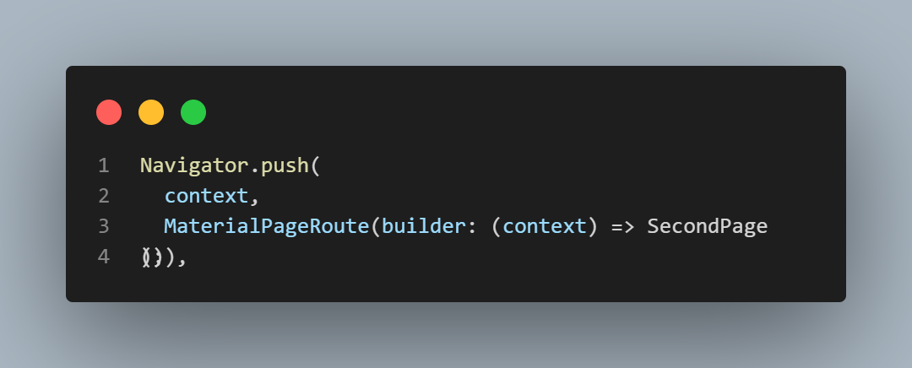
Navigation & Routing
1.Navigating to a new screen(PUSH)
Pushes SecondPage onto the navigation stack.
MaterialPageRoute creates a transition between pages.
S25' Training Sessions

Slide 19
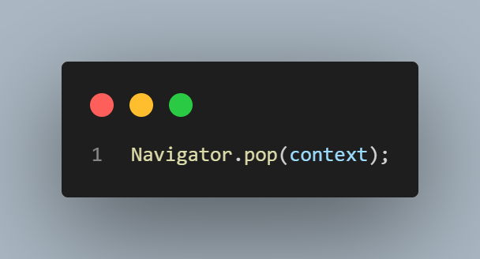
Navigation & Routing
2.Going Back to the Previous Screen (POP):
Removes the current page from the stack.
Returns to the previous screen.
S25' Training Sessions

Slide 20
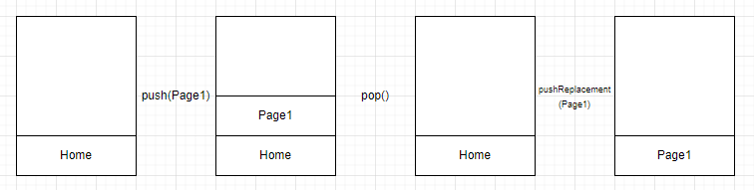
Navigation & Routing
S25' Training Sessions

Slide 21
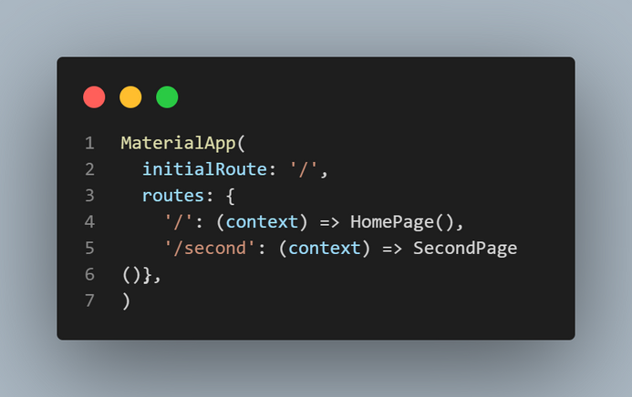
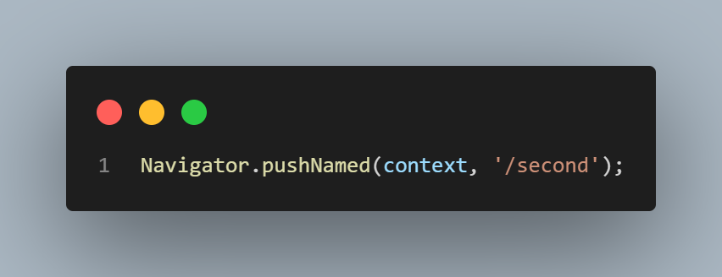
Navigation & Routing
Named Routes
Better for managing multiple screens.
1-Define routes in MaterialApp:
S25' Training Sessions
2-Navigate using:

Slide 22
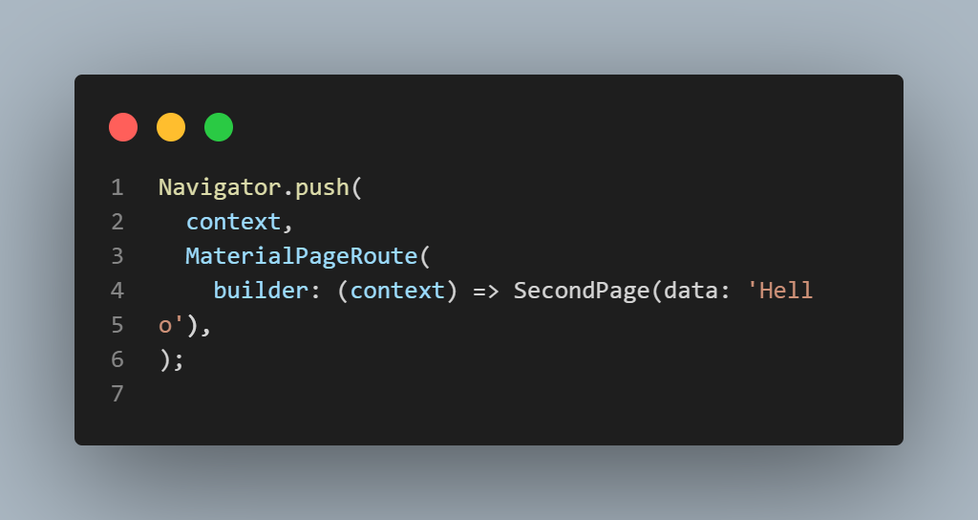
Navigation & Routing
Passing Data Between Screens
Passing Data with Navigator.push()
S25' Training Sessions

Slide 23
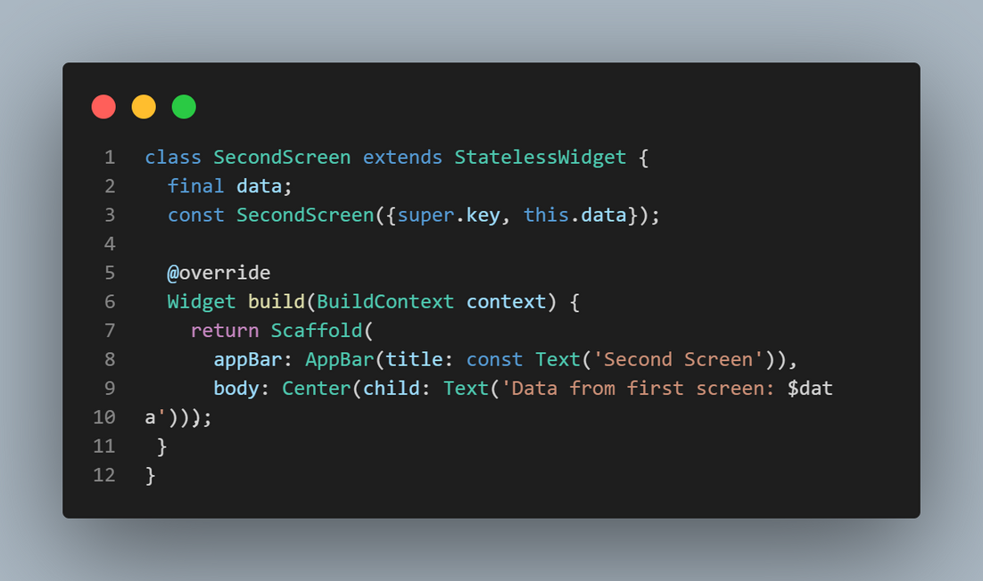
Navigation & Routing
Receive the data in SecondScreen
S25' Training Sessions

Slide 24
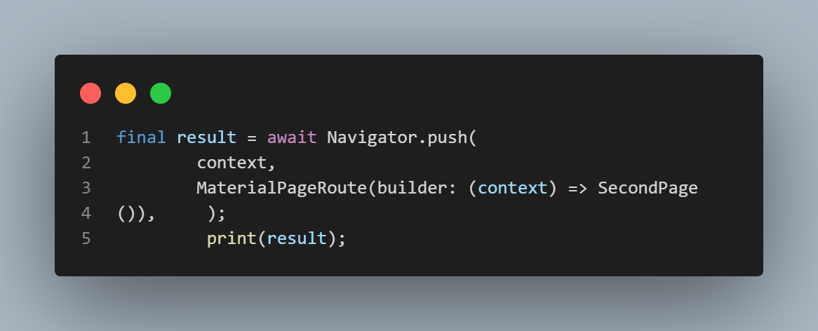
Navigation & Routing
Pop Method
Returning Data with Navigator.pop()
S25' Training Sessions
Used to send data back to the previous screen.

Slide 25
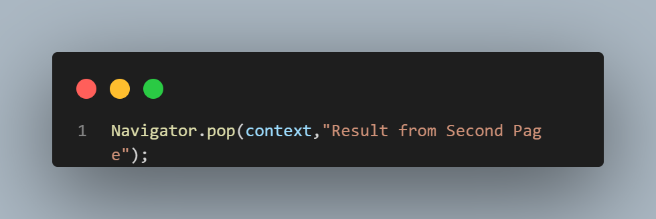
Navigation & Routing
Return data from SecondScreen:
S25' Training Sessions

Slide 26
Exercise
Create a basic Flutter app with two screens where:
1-Screen 1 (HomeScreen) has a button to navigate to Screen 2 (SecondScreen) and send a message using Navigator.push().
2- Screen 2 (SecondScreen) displays the received message and has a button to return a response using Navigator.pop().
3- The returned data is displayed on Screen 1 when the user comes back.
S25' Training Sessions

Slide 27
Responsive Widgets
What is Responsive UI?
UI that adapts to different screen sizes & orientations.
Essential for supporting phones, tablets, desktops, etc.
S25' Training Sessions
How to Achieve Responsive
1- Use MediaQuery – Get screen dimensions dynamically
2- Use Flexible Layout Widgets – Expanded, Flexible, etc.
3- Use Aspect Ratio & Intrinsic Dimensions

Slide 28
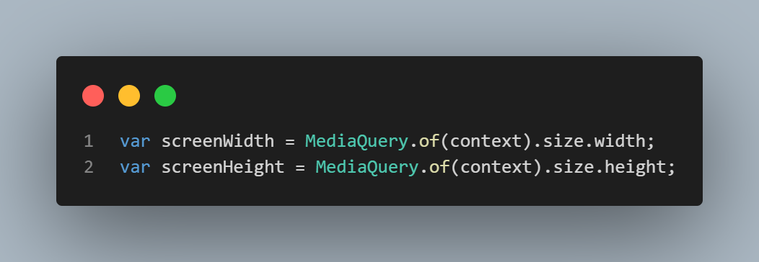
Responsive Widgets
1- MediaQuery (Get Screen Dimensions Dynamically)
What is MediaQuery?
A way to get device size, orientation, padding, etc.
S25' Training Sessions

Slide 29
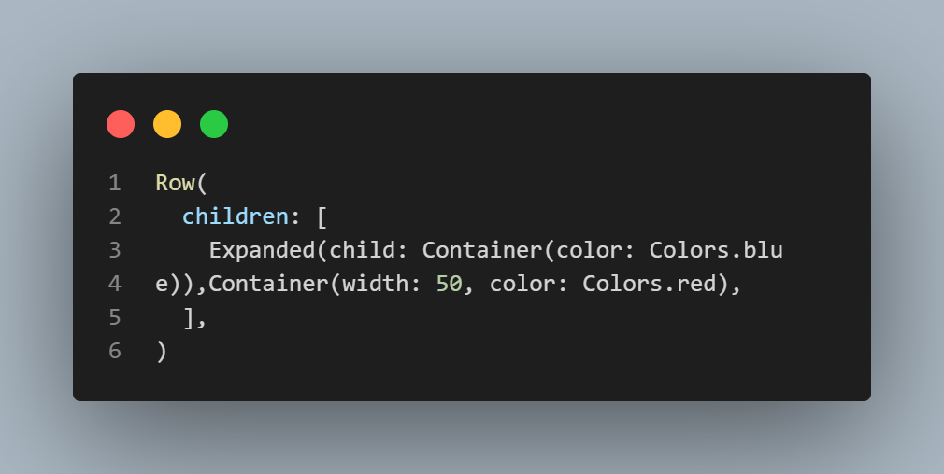
Responsive Widgets
2-Flexible Layout Widgets
1. Expanded:
Fills remaining space in Row/Column
S25' Training Sessions

Slide 30

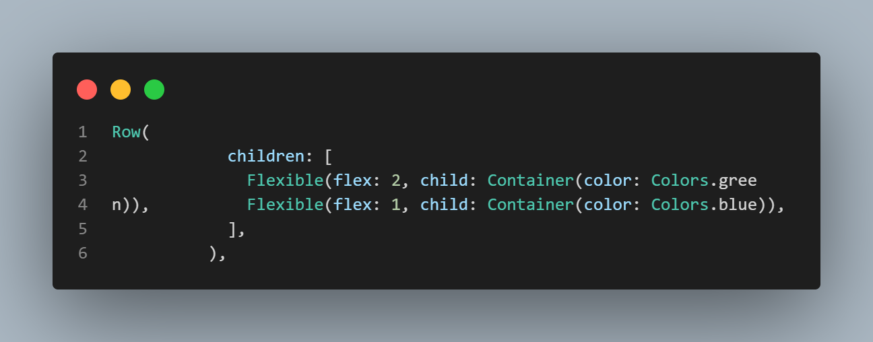
Responsive Widgets
2. Flexible:
Like Expanded but can shrink if needed
S25' Training Sessions

Slide 31
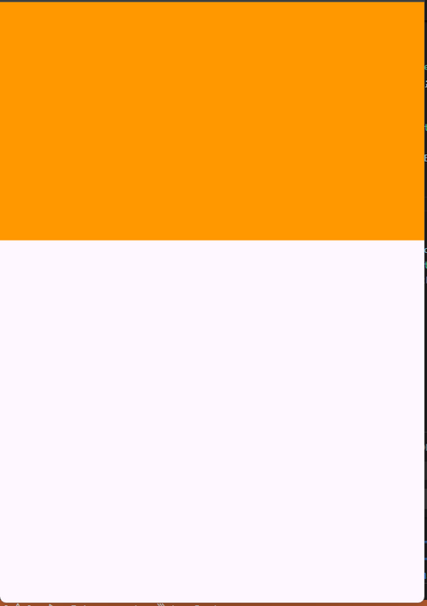
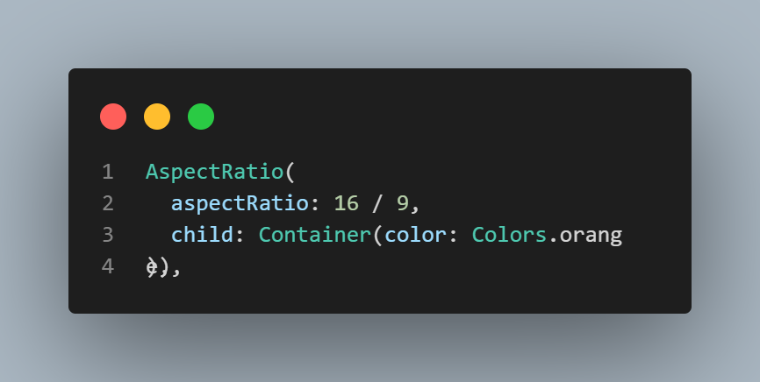
Responsive Widgets
AspectRatio & Intrinsic Dimensions
1. AspectRatio Widget:
Maintains a specific width-to-height ratio
S25' Training Sessions

Slide 32
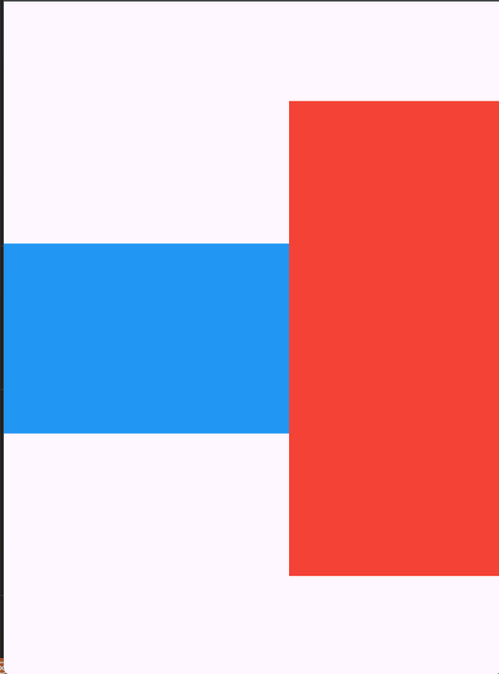
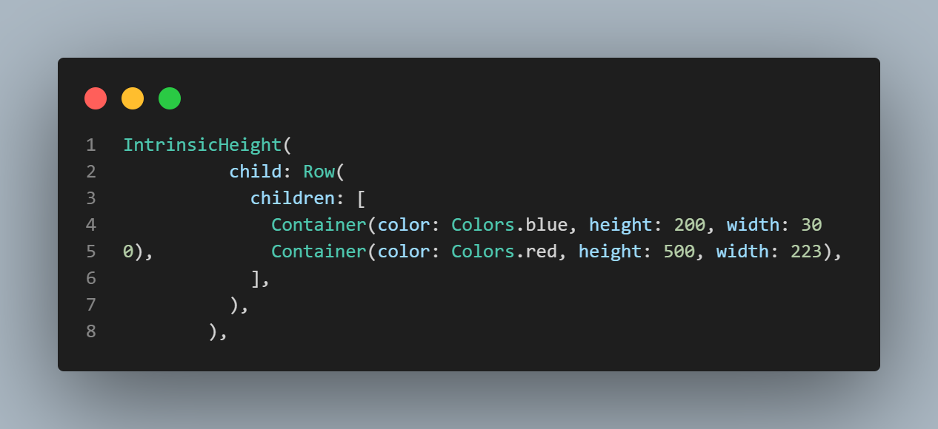
Responsive Widgets
IntrinsicWidth / IntrinsicHeight
Sizes widgets based on their content
S25' Training Sessions

Slide 33
Task
S25' Training Sessions
Upgrade your Notes App

Slide 34

THANK YOU
SEE YOU NEXT TIME
S25' Training Sessions

